Slide 1
Pathways Housing First! PROGRAM PHILOSOPHY AND PRACTICE
Sam Tsemberis, PhD
CEO Pathways National
Wellington, NZ October 21, 2015

Slide 2
Agenda
Homelessness – Cross Cultural Perspective
Housing First: Why the Need for a Different Approach?
Housing and Support Services
Philosophy and Program practice
Intensive Support Teams
Program Fidelity and Effectiveness
Q & A Discussion

Slide 3
Gini Coefficient: Income Disparity and Social Services
P. Toro, Income Disparity and Social Services.

Slide 4
Cross Cultural Similarities and Differences
Wide variations in social welfare systems
Definition of ‘homeless’ varies –Advocates, Policy Makers and researchers
Range from ‘Rough Sleepers or literally Homeless’ to stably housed
Single Adults – more men, higher rates of SA, Trauma, MI
Over representation of groups who are discriminated against
Typically refers to 3 major groups- Single Adults, families and Youth

Slide 5
Traditional Services Approach
Linear Residential Continuum of Care
Permanent housing
Transitional housing
Level of independence
Drop-In/
Shelter
Homeless
Based on traditional but unwarranted Treatment assumptions PLUS
Negative attributions toward the poor –
Notes:
5

Slide 6
Staircase: Unrealistic Expectations and a significant number cannot succeed

Slide 7
Why the chronically homeless?
Repeatedly failed by existing systems
Overwhelm existing systems to a disproportionate degree
Well known to the community
Consensus among multiple stakeholders
Opportunity to improve the overall system

Slide 8
Who is served by Housing First programs? Chronic & Episodically Homeless
10-15% episodically
80% transitionally homeless
5-10% chronically
Notes:
640 from

Slide 9
Trajectories for those who remain chronically homeless
10% of the population use 50% of system resources
Jail
Emergency
Rooms
Hospital/
Detox
Streets
Shelters
Institutional Circuit
Notes:
9
Talk through the institutional circuit…the rise of the idea of chronic homelessness and information management, etc. Discuss how the assumptions of the traditional approach doesn’t hold up; that people can’t overcome chronic conditions first (by their very nature and definition this is a flawed idea). Talk about the trauma that people experience, and their inability to care for themselves, loss of relationships, often within the context of depleted social networks…cumulative disadvantage…which will be important later in how we work with people.

Slide 10
Housing First Model
Permanent housing
Transitional housing
Emergency Shelter Placement
Direct access to permanent housing with supports
Client Choice
Homeless
Recovery Oriented Support and Treatment Services
Notes:
10

Slide 11
5 Dimensions of a Pathways’ Housing First Program Fidelity
Consumer Choice
Services Match Client Needs
Recovery Oriented Services
Separation of Housing and Services
Program Structure
Notes:
11

Slide 12
Why focus on the chronically homeless?
Existing systems repeatedly fail to engage/serve this group
Small % overwhelms systems (10% 50%)
Well known to the community
Consensus among multiple stakeholders
Opportunity to improve the overall system

Slide 13
Pine Street Inn, Boston
– Lydia Downey from Managing to Ending homelessness

Slide 14
Shelter utilization and capacity ‘let’s do the math’
Shelter of 100 beds = 36,500 bed nights
Average stay per guest:
3 nights x 50 people = 150 bed nights
180 nights x 5 people = 900 bed nights
3 nights per guest = 12, 168 guests/year
180 nights per guest= 202 guests/year

Slide 15
Immediate Access to Housing and Appropriate Supports
Elements of the Paradigm Shift

Slide 16
Housing First Requires Change
Change in view of those served
Change in goals of the system
Change in power relationships
Change in locus of care
Change in treatment culture
Change in funding patterns

Slide 17
Programs Stages of Change
Pre-
contemplation
Contemplation
Preparation
Action
Maintenance
Relapse

Slide 18
Immediate Access to Housing and Appropriate Supports
Elements of the Paradigm Shift

Slide 19
Housing First Requires Change
Change in view of those served
Change in goals of the system
Change in power relationships
Change in locus of care
Change in treatment culture
Change in funding patterns

Slide 20
Programs Stages of Change
Pre-
contemplation
Contemplation
Preparation
Action
Maintenance
Relapse

Slide 21
HUD Continuum of Care Encouraging Housing First
Extent to which PSH programs within a Community implement a Housing First approach
Prioritization of chronic homelessness
Housing offered without preconditions
Rapid placement (and stabilization)
in permanent housing with supports

Slide 22
Current System
shelter
Housing
St support
Centralized
Assessment and
Centralized Entry
Housing
Mod
support
Housing
High
support
street

Slide 23
Pine Street Inn, Boston
– Lydia Downey from Managing to Ending homelessness

Slide 24
Shelter utilization and capacity ‘let’s do the math’
Shelter of 100 beds = 36,500 bed nights
Average stay per guest:
3 nights x 50 people = 150 bed nights
180 nights x 5 people = 900 bed nights
3 nights per guest = 12, 168 guests/year
180 nights per guest= 202 guests/year

Slide 25
Steps needed to Introduce System Change Intervention
Target Population: Community sets priority among homeless population
Collaboration: Partnership among agencies (identification, data sharing, resource sharing, etc.)
Operations: Design or re-design system so there is a clear map for all providers and participants
Measure: Set specific targets and timelines and trach outcomes as a community (transparency)
Leadership/Collaboration model

Slide 26
5 Dimensions of a Pathways’ Housing First Program Fidelity
Consumer Choice
Services Match Client Needs
Separation of Housing and Services
Recovery Oriented Services
Program structure
Notes:
26

Slide 27
Choice in Housing (Pragmatic and Context Bound)
Choice in availability
(social & rental)
Match client choice and availability
Tenants agreements
Affordable & decent
Integrated into the community
Permanent

Slide 28
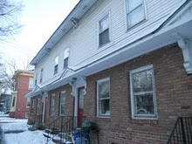
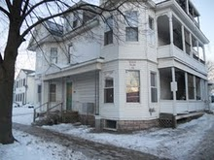
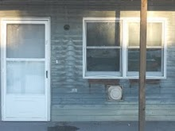
200 Tenants, 200 Apartments, 2 Counties, 6 Cities, 95 Landlords: Housing Retention Rate 90.5% (12 mo)
Pathways Vermont,
Housing First in Rural Settings

Slide 29
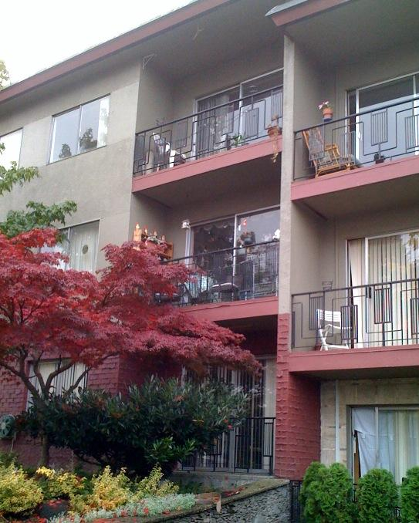
Rental Housing Community Landlords as Partners
Guaranteed rent
Support for tenancy
No vacancy loss
Program responsible for damages
Recognition for help in solving problems
All have common goal: safe, decent, well-managed housing

Slide 30
Housing First; Providing Housing
HOUSING FIRST provides immediate access to housing
Programs find ways to engage private market or landlords or social housing
Rent or rent supplements are essential
Best practice target: provide access between 2-4 weeks from date of admission

Slide 31
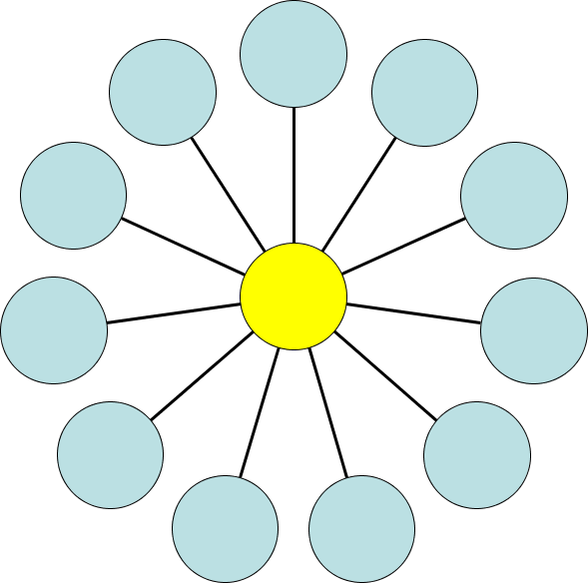
1b. Choice and SERVICES “NO WRONG DOOR”
Friends & Family
Spiritual
Education
Documents/
Legal
EMPLOY
MENT
CLIENT
HEALTH
SOCIAL
SUPPPORT
Arts /
Creativity
Addiction
Tx
Mental
Health
SELF-DETERMINATION
IS THE FOUNDATION OF
PROGRAM PHILOSOPHY
HOUSING
Notes:
Discuss service choices

Slide 32
2. MATCHING SERVICE NEEDS Community based, responsive, and flexible
High Need
ACT - a multidisciplinary team and provides support and services directly
Caseload 1 to 10
Work as Team
Services provided in the participant’s home or community (group meetings offered at offices or other community settings)
Off site and on-call services 7-24
Moderate Need
ICM - case management team provides support and brokers services
Case loads of 1 to 15/20
FACT Team provides blended model
All teams use a recovery orientation
Notes:
32
Discuss the historical piece and how in this intervention we are doing a blend of services …. Case mangement plus, ACT lite, many sites are augmenting services

Slide 33
Limits to Choice: SERVICES
Home visits are mandatory and frequency may be increased to meet new circumstances
Planning for crises (WRAP plan) anticipates problems and provides a mutually agreed upon blueprint for response
(e.g., medical, emotional, relapse, may include additional support, or hospitalization)

Slide 34
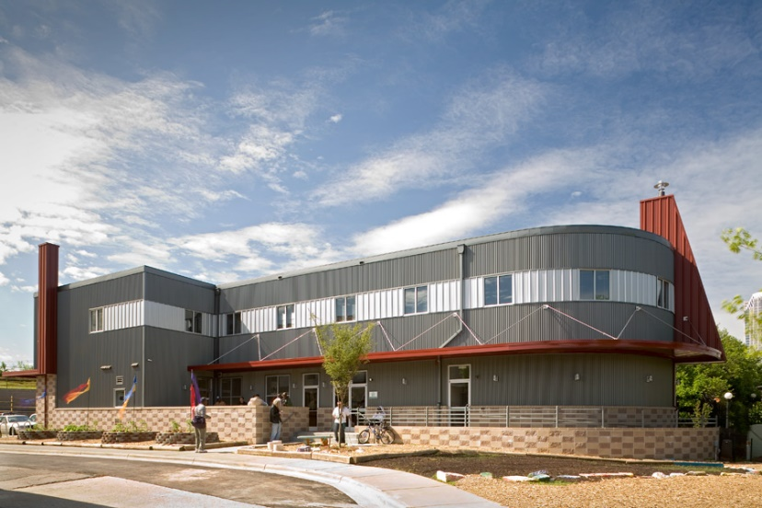
3. Separation of Housing and Services
Separated spatially,
conceptually,
and operationally

Slide 35
PRINCIPLE 3: HOUSING and SERVICES ARE SEAPARATE DOMAINS
Housing Domain
Services Domain
Clinical services and case management Benefits/entitlements/case management
Recovery goals; family reconnection, social, educational, employment
Apartment selection, set up
Agree to terms of standard lease
Lease signing, security, furnishing
Rent payments and managing the apartment and the tenancy
Treatment goals: mental and physical health; addiction

Slide 36
Another Dimension of the Paradigm Shift is the Treatment Philosophy
4. Recovery Oriented Services

Slide 37
System Change Question
Can we simply introduce a new program into an existing system and keep everything else the same?

Slide 38
Treatment Philosophy
What Are Recovery Focused Services?
What is a welcoming culture?
What is trauma informed and trauma competent?
Why use Harm Reduction?

Slide 39
Housing First Services Requires Change in Orientation and Practice
Change in…
view of those served
goals of the system (maintenance to rehabilitation)
power relationships (shared decision making)
focus and locus of care
treatment culture

Slide 40
Harm Reduction and
Housing First
Harm Reduction in Everyday Life

Slide 41
Harm Reduction and Housing First
Harm Reduction is not limited to working with addiction
Seek to reduce the risks associated with any harmful behaviors (safe injection, psychiatric symptoms, eviction, explotation, etc.)
HR allows for consumer directed services
Allows for honest discourse
HR involves tolerance of risk by staff and agency
Notes:
Harm reduction is another part of the Housing First service philosophy. The Harm Reduction Coalition defines harm reduction as: A perspective and a set of practical strategies to reduce the negative consequences of drug use (food, relationships, finances), incorporating a spectrum of strategies from safer use to abstinence. Exampes of harm reduction include: - Condom use
- Change patterns of use (amount, timing, location)
- Superficial cutting vs. jabbing knife into leg
- Needle exchange
- Methadone (substitution therapy)

Slide 42
Historical Approaches to Alcohol/Drug Treatment
Demand/mandate reduction
Locating the problem in the substance,
not the person
Moral theory/fellowship
Locating the problem in the person,
not the substance
War on Drugs became the war on drug users
Criminal justice model
Reduce supply/prohibition

Slide 43
Harm Reductions
A perspective on treatment that includes a set of practical strategies to reduce the negative consequences of drug use (food, relationships, finances), that incorporates a spectrum of strategies from safer use to abstinence.
-The Harm Reduction Coalition

Slide 44
Narrative Therapy
Language does not simply reflect reality it constructs reality
e.g., Addicts vs people who use substances
Naming the problem and locating the problem outside the person
Allows us to unite with the person against the problem
Michael White and
David Epston
At Home/Chez Soi: Brian Williams and Barbara Baumgarten (2013)

Slide 45
Principles of Harm Reduction - Intervention
Person
Context
Drug
Meet people where they are
Understanding why they use
Understand under which conditions are they more prone to use
Relapse plans = expected part of recovery
Strengths based- gains rather than losses approach - noting time reduction or abstinence is maintained
**
** targeted behavior

Slide 46
Strategies/Interventions include:
Controlled Use
Goal is to reduce the harm by reducing consumption or by controlling episodes/situation of use
Application
Applied in self-help support groups (Moderation Management; www.moderation.org)
Some dual disorder programs
Some harm reduction/needle exchange programs
Some housing programs

Slide 47
Substitution Therapy
Goal is to replace one drug with a high associated risk with another drug of a lower risk
Application
Methadone maintenance
Nicotine replacement strategies
Physician-prescribed drugs

Slide 48
Examples of Reducing Risks
Using a screen or rubber tubing for
crack use
Getting off the bus two stops earlier
and walking
Switching timing
Paying rent before buying substances
Buying a pint or 6 pack instead of a
quart
Buy loosie instead of a pack

Slide 49
Harm Reduction and Housing First
“Attitude is not everything, it is nearly everything” –Bert Pepper, MD
Harm reduction is:
An integral part of Housing First
Rooted in unconditional positive regard for the individual
Social justice based—Housing is a basic human right.

Slide 50
Decisional Balance: Having open and honest conversation
What are the costs and benefits of
changing vs. not changing behavior?
Option | Benefits | Costs
Making Change (reducing alcohol) | Family would trust me again More money Better health | Won’t have a way to relax Lose my friends Life will be boring
Not Changing | Helps me relax I Feel like I fit in Love the buzz I get | Less money Cannot see my kids Legal problems

Slide 51
Home Visits: Up Close and Personal
Home visit provides opportunity for observation of entire life space
Observe and possibility to intervene in areas of health, mental health, self care, hygiene, social life, nutrition, community participation and more
What is the most respectful, empowering, and effective way to address the issues we observe? (stage of change is issue specific not person specific**)

Slide 52
Housing First and Harm Reduction
Meet people where they are…
but don’t leave them there.

Slide 53
Recovery Orientation
- Staff and Agency orientation
- Inter-personal
(you are an active agent in the treatment and outcome)

Slide 54
World Health Organization (WHO) Studies on Outcomes for Severe Mental Illness
Outcomes at two years and five years, the patients in the developing countries had a “considerably better course and outcome.”
Report concludes “being in a developed country was a strong predictor of not attaining a complete remission.”
They also found that “an exceptionally good social outcome characterized the patients” in developing countries.
Source: Jablensky, A. “Schizophrenia, manifestations, incidence and course in different cultures.” Psychological Medicine 20, monograph
(1992):1-95.

Slide 55
WHO Studies (continued)
Medication usage (Robert Whitaker:
Mad in America, 2002.)
16% of patients in the developing countries were regularly maintained on antipsychotics
61% of the patients in wealthier countries.
15-year to 20-year follow-up:
53% of schizophrenia patients had favorable outcomes, were “never psychotic” after first 2 years, and of those 73% were employed.
Source: Harrison et al., in Schizophrenia Bulletin June 2001.

Slide 56
Recovery, Homelessness, and Stages of Change
Recovery is a personal journey of healing and transformation
It is reclaiming a full life in the community despite the experience of psychiatric disability and substance use issues
Recovery is an on-going process, takes time, and is multi-dimensional (and there are bumps along the way)
Ending homelessness can be immediate recovery takes time

Slide 57
Life’s domains develop at different pace
Living situation
Employment
Intimate Relationship
Health/Wellness
Social supports
Leisure/recreation
Education
Spirituality

Slide 58
Recovery and Peer Support
What helps?
What hinders?
No substitute for peer support
We need to expand definition of ‘services’
Notes:
Summarize and emphasize the idea of where the locus of control is.. That is now with the client.. Give a hint about why MI works well with this perspective

Slide 59
Graduation and Recovery: Social Networks, Life Not Defined by Illness, Community Integration
Social, Friends, and Family
+Positive reconnections
Team Supports Wellness
Self Management
Teaching rather than doing
+New social possibilities
- Discontinuity with street friends
- Additional responsibilities and stress
+New roles and responsibilities for consumers and staff

Slide 60
Social Inclusion and Community Integration

Slide 61
Promoting Social Inclusion
Term ‘Social Inclusion’ originated in Europe
Society and its institutions actively promote opportunities for the participation of excluded persons including persons with psychiatric disabilities, in mainstream social, economic, educational, recreational, and cultural resources.
Full recovery can only occur when people with mental illnesses have the means and access to full-fledged membership in their communities (Thompson and Rowe, Psych Services, August 2010).

Slide 62
Break
Next Up….
Program Fidelity

Slide 63
Pathways Housing First Program
What is Program Fidelity?
How do you Measure it?
Why does it matter?
https://samhsa.gov/nationalregistry

Slide 64
Why Fidelity?

Slide 65
Components of Program Fidelity
Assess the extent to which components of the program model are being implemented
Structural features:
what does the housing look like?
What services are provided?
Philosophy, values: participant choice? Harm reduction?

Slide 66
The case of Housing First…
”It’s all about Housing & Choice”
Pathways Housing First Fidelity Scale Results: Program Spectrum
“Participants can choose the housing they want regardless of whether they are actively using.”
“Participants can choose to be clean and sober and they’ll get an apartment. Or they can choose to continue using and we’ll still give them housing in a room & board”

Slide 67
Why Fidelity?
Housing First is not Housing Only
Housing First is not “Housing is the first thing after they…”
Choice is not laissez-faire
Assertive engagement is not coercion
Peer Specialists are not junior case managers
Understand current practice & make improvements
Maximize outcomes

Slide 68
Housing First: Fidelity Scale Development
Pathways Housing First Fidelity
PSH Fidelity Scale
T-MACT Fidelity Scale
DACTS Fidelity Scale
Surveying own programs and Early HF Adapters
Housing First Descriptions
Stefancic, A., et al., in the American Journal of Psychiatric Rehabilitation (Special Issue on Pathways’ Housing First), December, 2013.

Slide 69
Multiple Uses of Fidelity
Fidelity: determine the degree to which the key components of the Housing First model are being implemented
Program Development
Guide programs in implementing and operating the model?
Targeted Technical Assistance
What specific areas does a program need to improve?
Research/Program Outcomes
How are program components linked to outcomes?
Notes:
Further understanding what the program is doing and looking at important outcomes, such as consumer goals and whether they are being met.

Slide 70
Housing First: Hi-Fidelity

Slide 71
Few programs achieve perfect scores

Slide 72
Removing Essential Components…

Slide 73
Pathways Housing First Fidelity Dimensions
5 Domains:
1) Housing Choice & Structure
2) Separation of Housing & Treatment
3) Service Philosophy
4) Service Array (Match Needs)
5) Program Structure

Slide 74
Sample Items
Rights of Tenancy, affordability, integration
No housing readiness requirements
No treatment contingencies: Can keep housing as long as participant follows a standard lease
Extent of implementation of harm reduction
Availability of services for assistance with psychiatric, substance abuse, employment/educational, and social integration needs

Slide 75
Pathways Housing First Program Effectivenss
Is it Effective?
How Do you Measure Effectiveness?

Slide 76
Fidelity Self-Assessment Survey & Residential Outcomes for California Full Service Partnerships
93 programs
6,584 participants
Diagnosis – Schizophrenia 62%
Housing Outcomes 1 year pre- and post-enrollment into housing & services

Slide 77
FSP Fidelity & Outcomes
High fidelity programs: Better targeting - Enrolled consumers with much longer histories of homelessness (High = 101, Low = 46) and higher rates of substance abuse
Days living independently in an apartment or SRO increased among high fidelity programs, but declined among low fidelity programs
UCSD: Gilmer et al., Psychiatric Services, 2014

Slide 78
Fidelity Self-Assessment Survey & Residential Outcomes
California FSPs:
93 programs
6,584 participants
Schizophrenia: 62%
Bipolar Disorder: 22%
Major Depression: 16%
Substance Abuse Disorder: 50%
Administrative Data
One year pre-post FSP enrollment
Residential Outcomes (days spent in living situation)
(Todd Gilmer, UCSD, Archives Gen Psych. 2010)
Notes:
Further understanding what the program is doing and looking at important outcomes, such as consumer goals and whether they are being met.

Slide 79
Housing First Self-Assessment Survey: Overall Fidelity & Residential Outcomes
High Fidelity programs: Enrolled consumers with much longer histories of homelessness
High = 101 days Low = 46 days
Declines in homelessness were greater among high fidelity programs. (p = .039)
Days living independently in an apartment or SRO increased among high fidelity programs, but declined among low fidelity programs (p<.01)
UCSD: Gilmer et al., Psychiatric Services, 2014
Notes:
Further understanding what the program is doing and looking at important outcomes, such as consumer goals and whether they are being met.

Slide 80
Housing First for Persons with Substance Use Problems
9 Scatter-site Housing Providers (NYC)
358 Participants
Modified Fidelity Assessment
Participants in programs with greater Housing First fidelity along principles of client-centered services and harm reduction interventions/open communication:
More likely to stay in housing
Less likely to report using stimulants, opiates at 1-yr follow-up
CASAColumbia: Davidson et al., 2014, Psychiatric Services

Slide 81
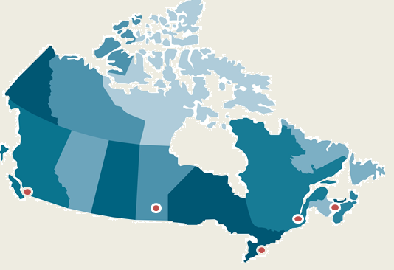
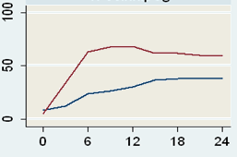
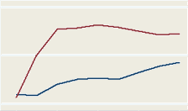
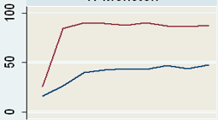
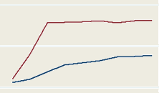
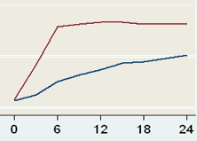
Housing First is Effective in Cities of Different Sizes and Composition Across Canada
Vancouver
Pop: 578, 000
Moncton
Pop: 107,000
Winnipeg
Pop: 633, 000
Montreal
Pop: 1,621,000
Toronto
Pop: 2,503,000
Notes:
The graphs show that housing stability does not differ much across the sites. On the y axis is the % of time spent in stable housing, and on the x axis is the number of months spent in the study. The red line represents participants receiving the Housing First Intervention, the blue line represents the participants receiving treatment as usual.

Slide 82
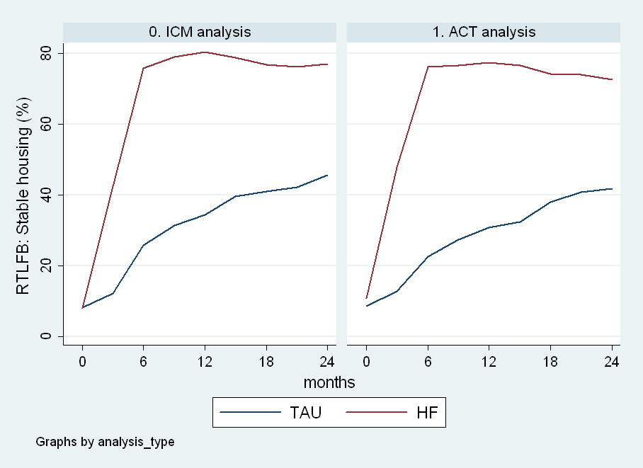
Housing First Achieves Similar Housing Outcomes for Moderate and High Need Participants
Percentage of time housed

Slide 83
Cost Offsets Vary Depending on Need Level
Cost Analysis: HF with ACT
Housing First costs $22K per person per year
Average net cost offset of $21.4K CAD (96%) per person.
$10 CAD invested in HF with ACT saved $9.60 CAD
Cost Analysis: HF with ICM
Housing First costs $14K CAD per person per year
Average net cost offset of $4.8K CAD (34%) per person.
$10 CAD invested in HF with ICM saved $3.42 CAD

Slide 84
Key Point About Program Fidelity
High program fidelity is associated with greater housing stability and quality of life.

Slide 85
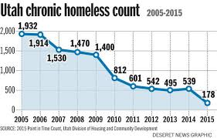
Ending Chronic Homelessness

Slide 86
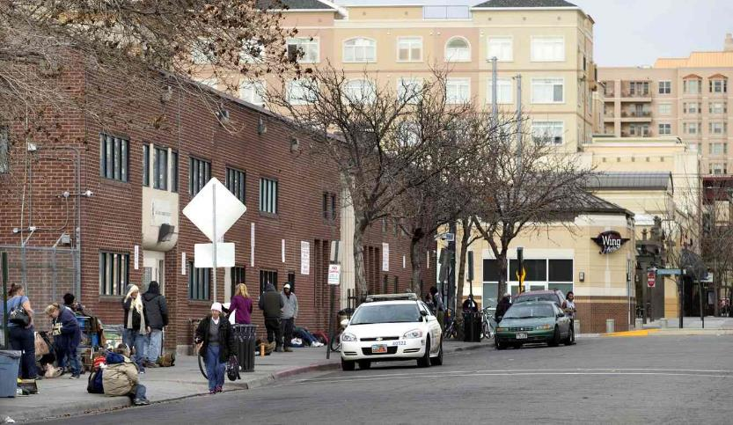
The Road Home SLC, Utah

Slide 87
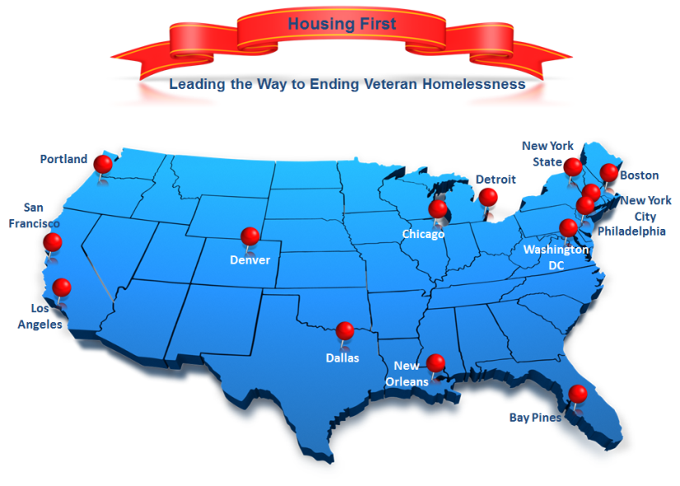

Slide 88
Thank you!
Questions?
For additional information:
pathwaystohousing.org
www.mentalhealthcommission.ca
www.homelesshub.ca
sam@pathwaysnational.org

